Slide 1
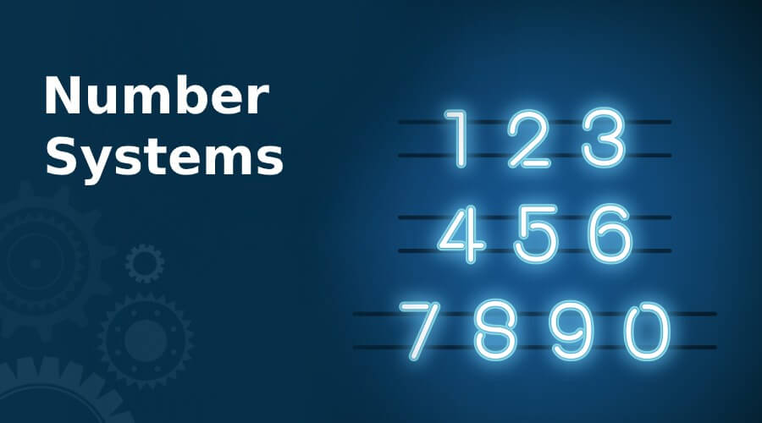
Presented by:
-Ishtyaq Ahmed Abdullah
-Mahamudul Islam Himel
-Md Rahat
-Nahid Al Galib
-Md Jubayer Al Asif

Slide 2
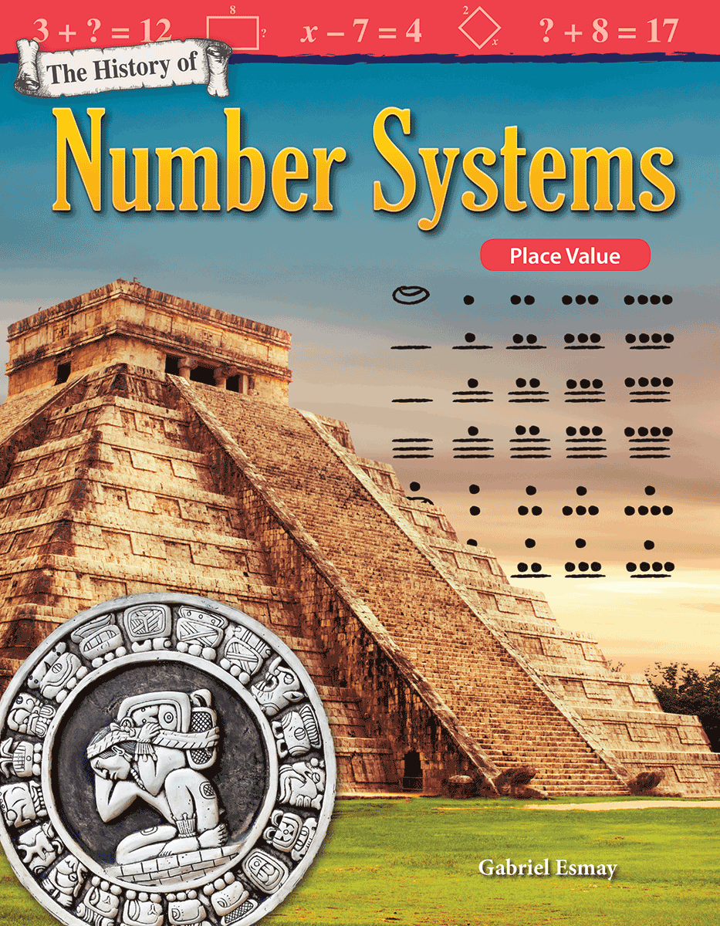
History of Number Systum
Number systems have progressed from the use of fingers and tally marks, perhaps more than 40,000 years ago, to the use of sets of glyphs able to represent any conceivable number efficiently.

Slide 3
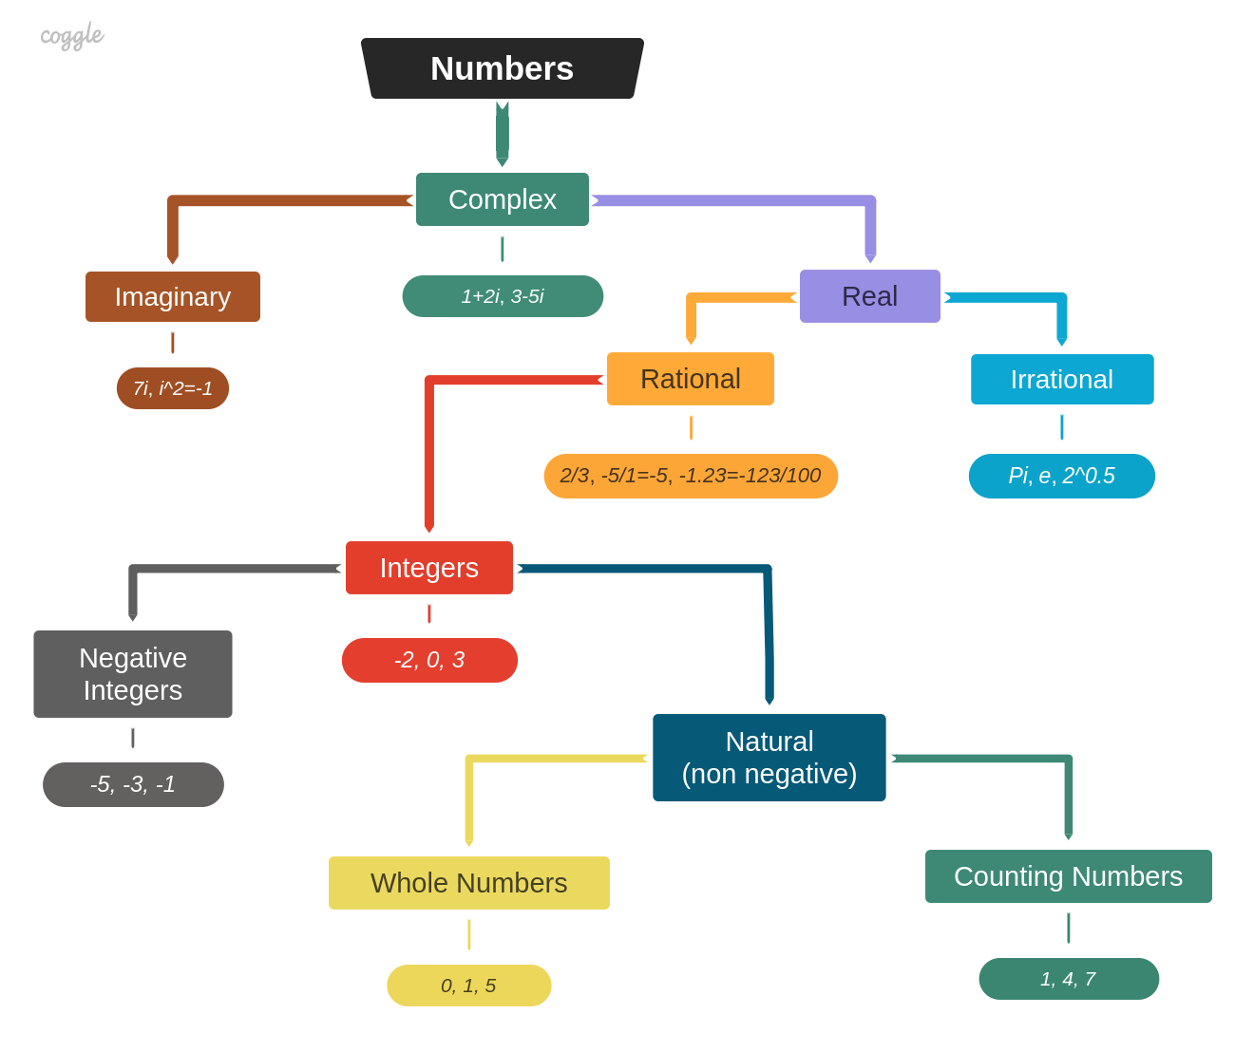
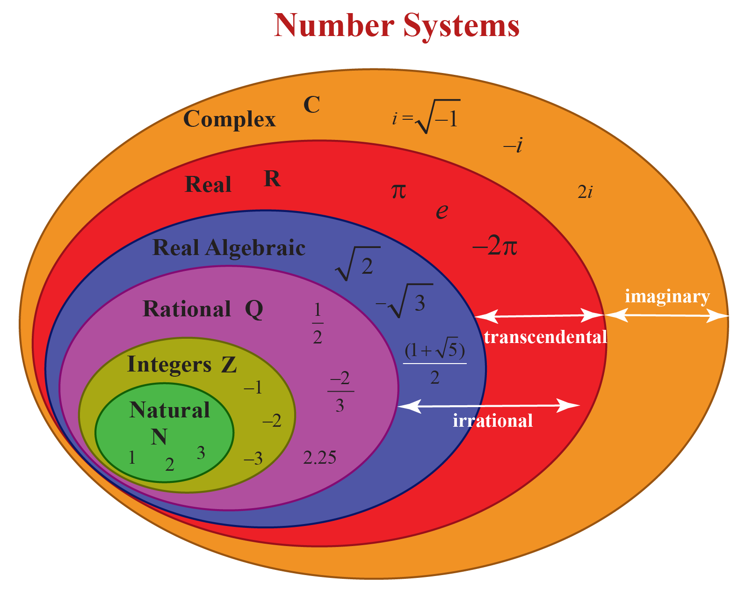
Classification of numbers

Slide 4
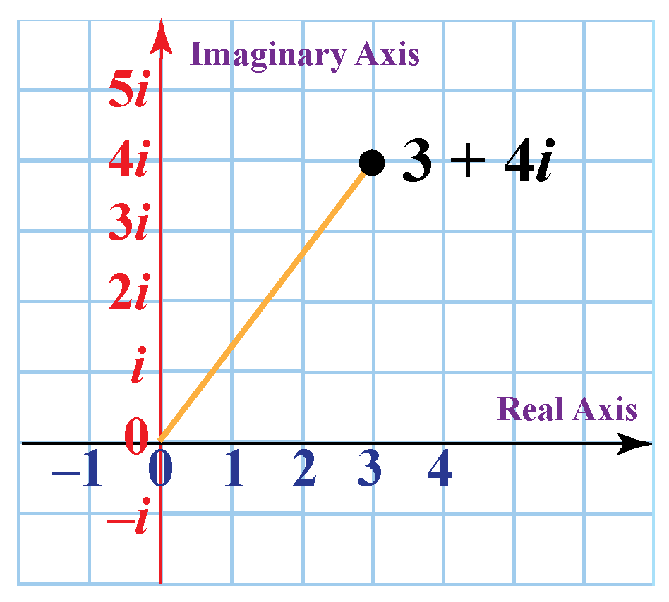
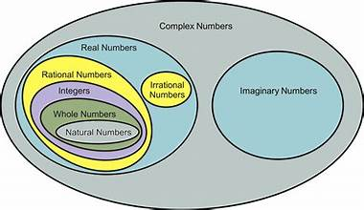
Complex Number
Here i is a imaginary unit

Slide 5
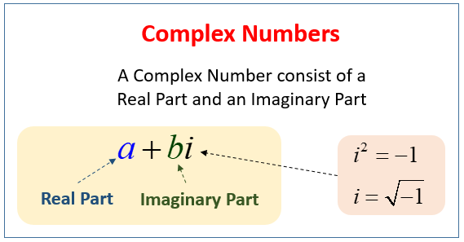
Real Part
Complex Number
Imaginary Part
Main difference between real part and imaginary part is i.
Imaginary always carry a imaginary unit i.

Slide 6
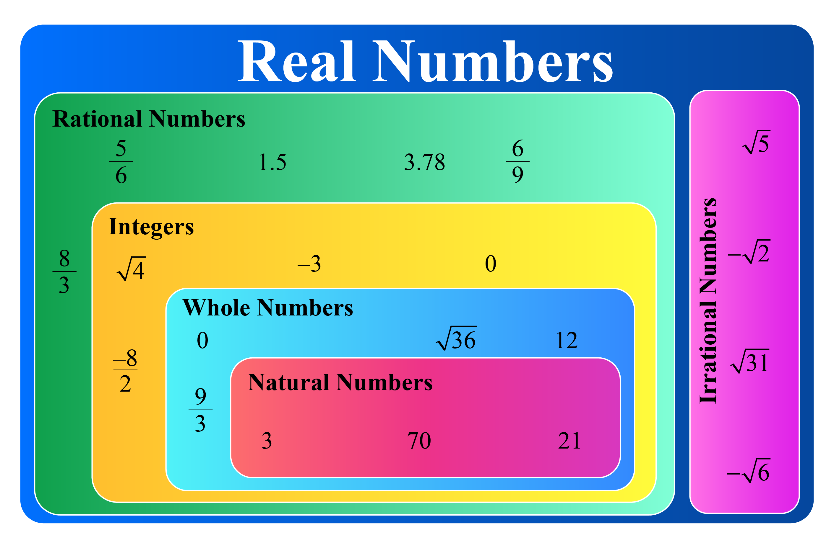
REAL NUMBER
Rational
Irrational

Slide 7
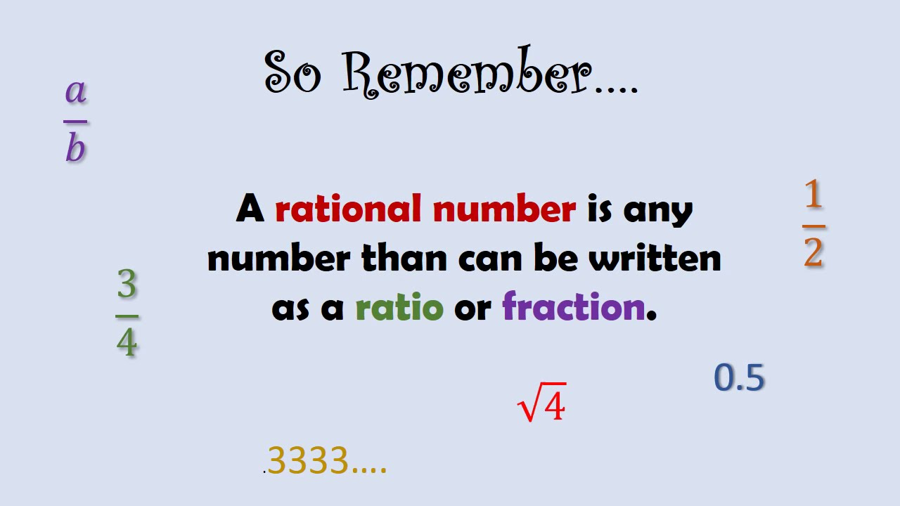
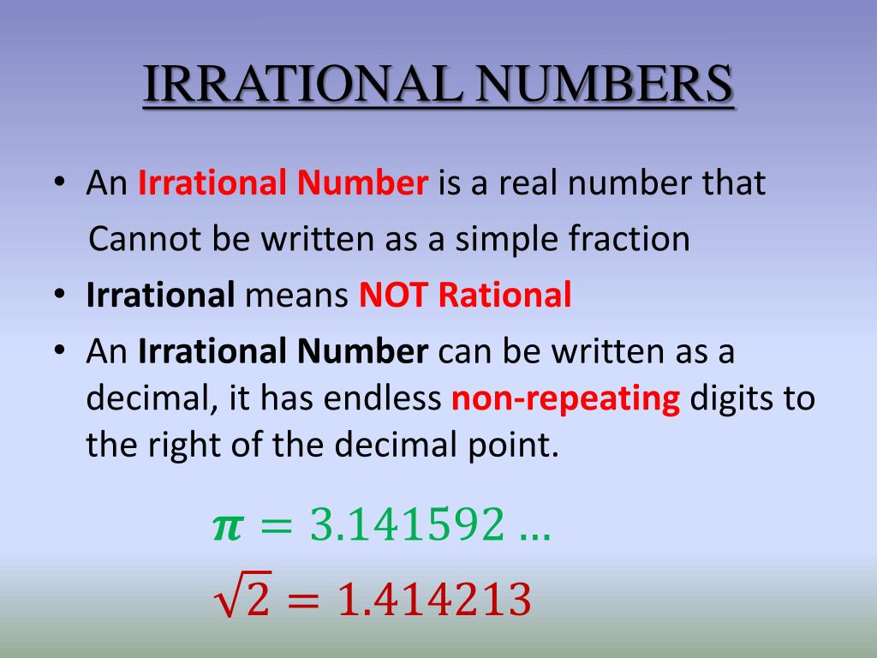
Real Number
Rational
number
Irrational
number

Slide 8
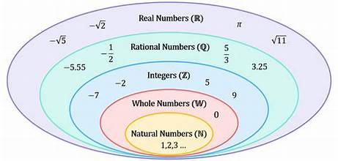
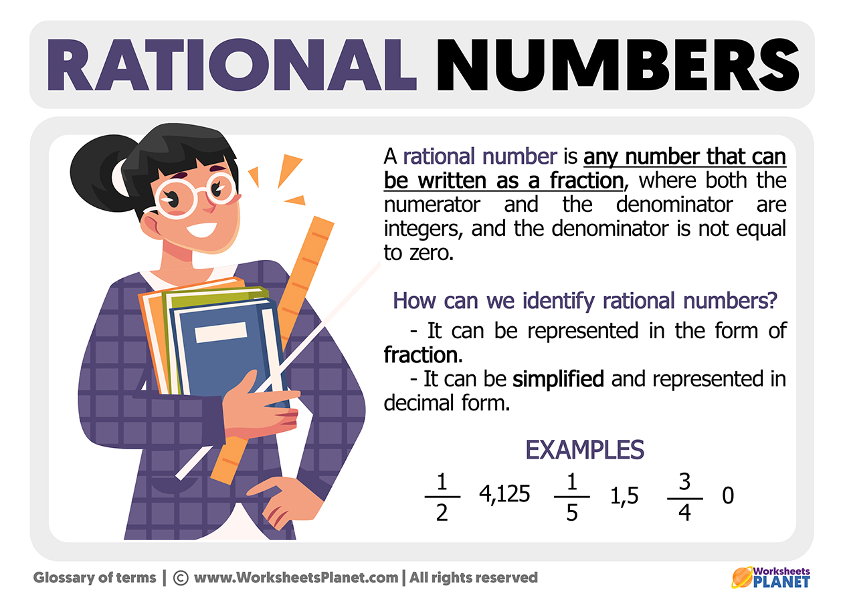
Rational Number

Slide 9
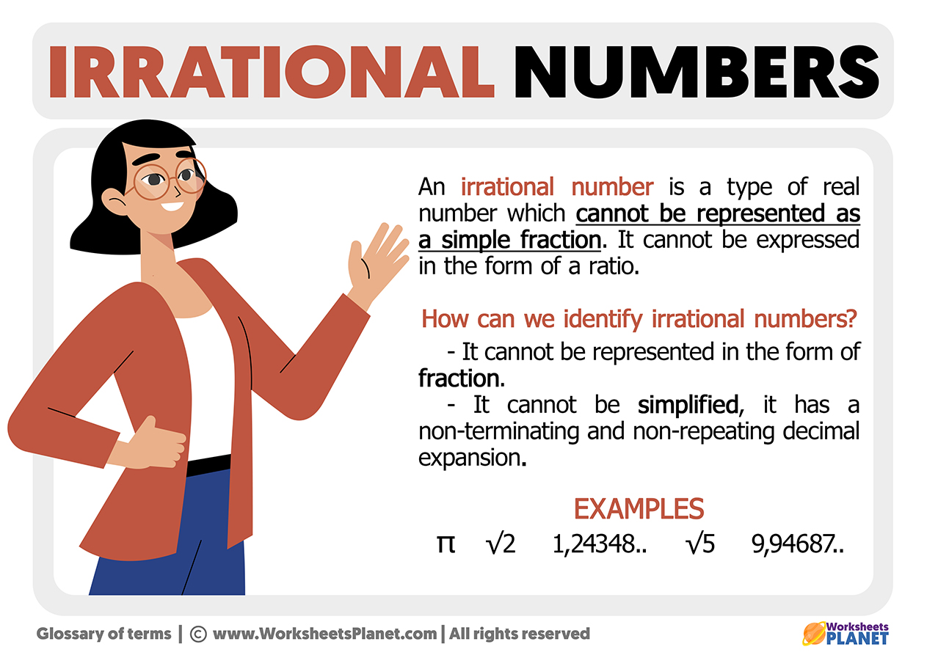
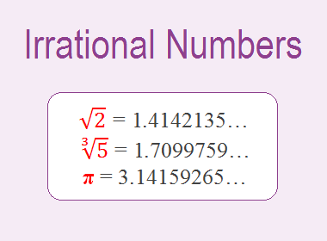
Irrational Number

Slide 10
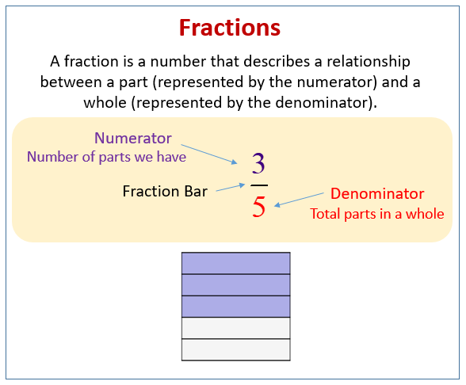
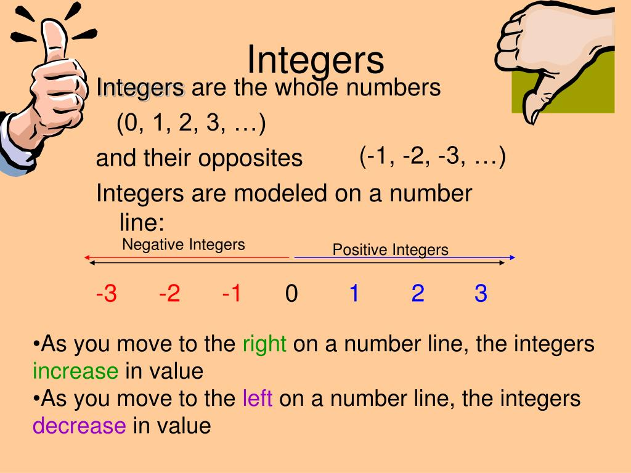
Real Number
Integer
Fraction

Slide 11
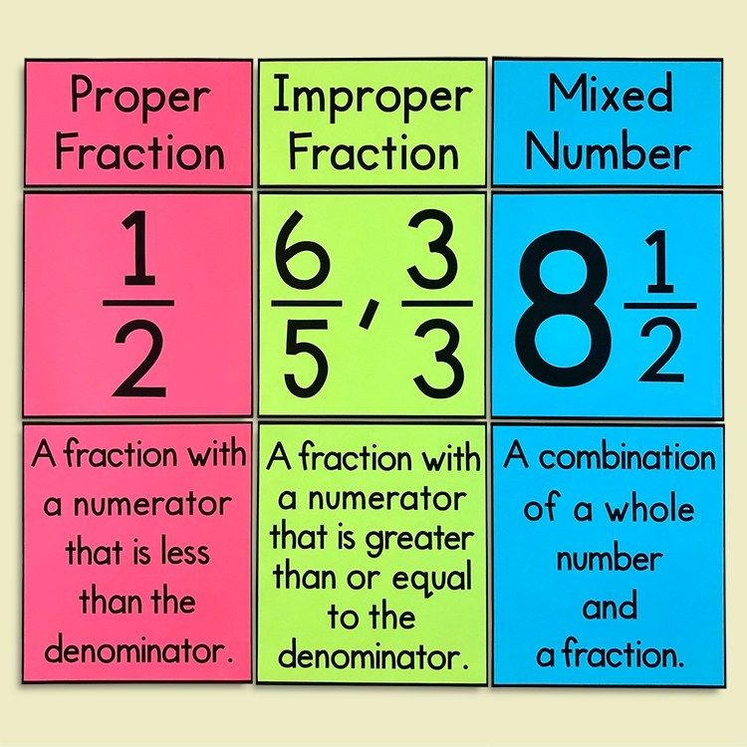
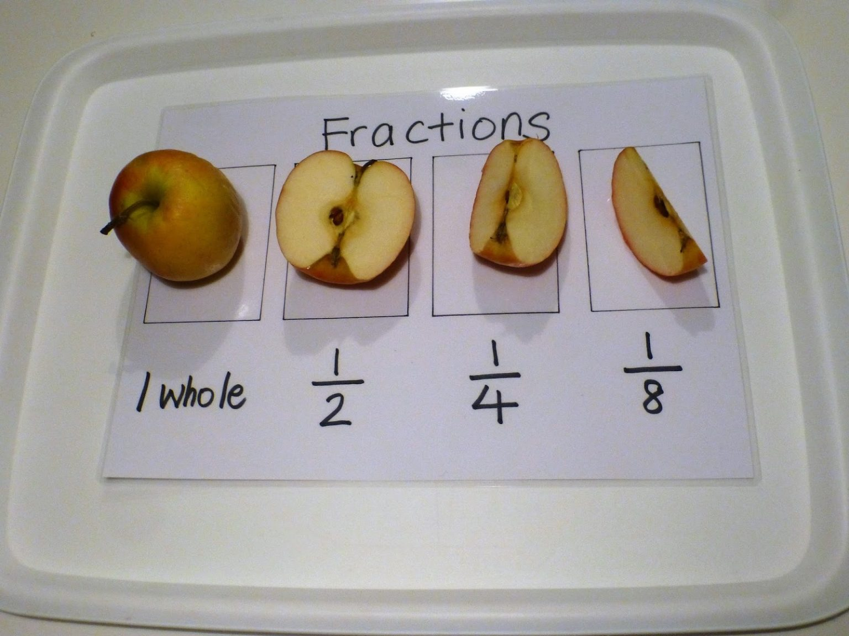
There are three type of fraction:

Slide 12
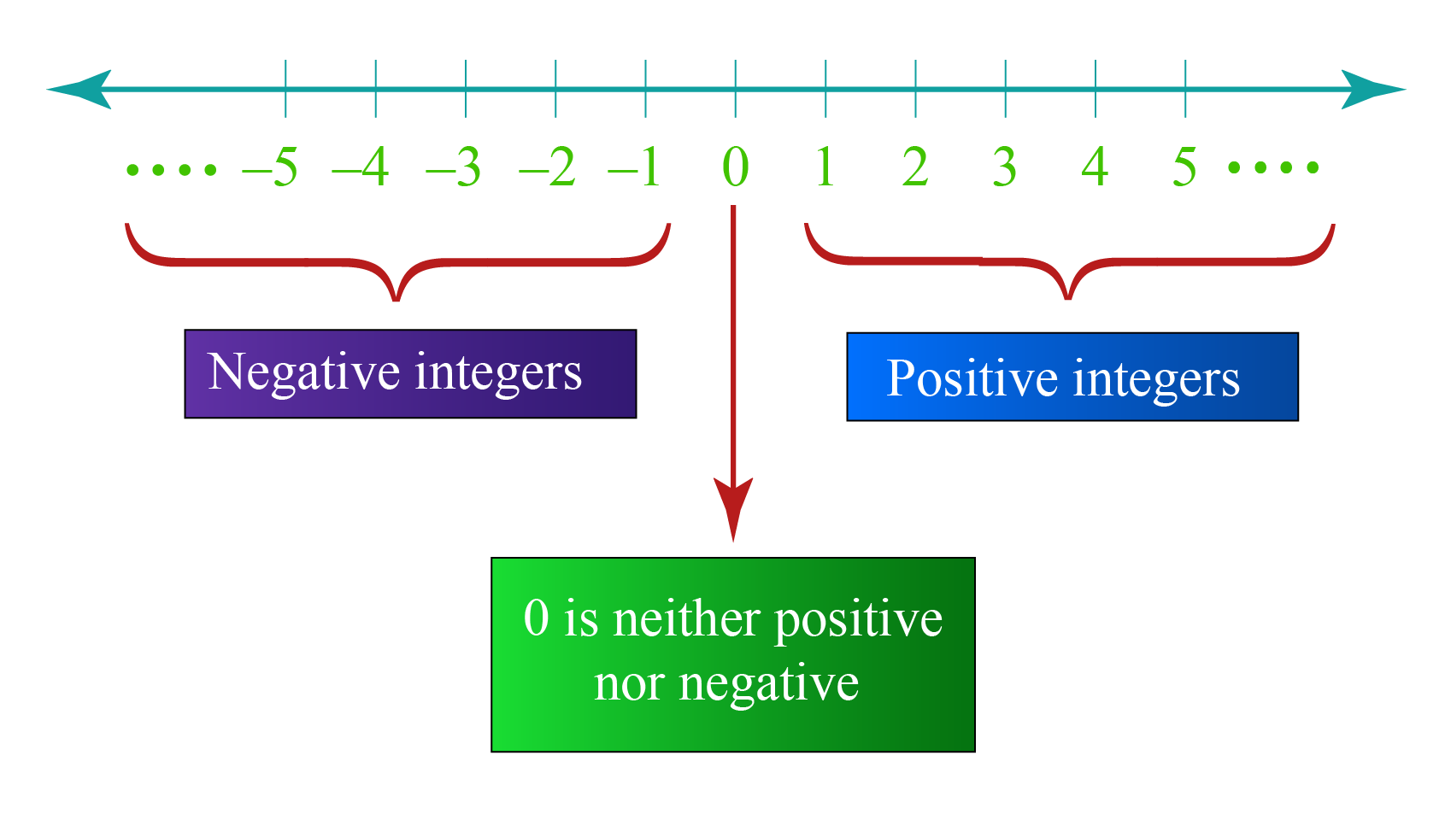
Integer

Slide 13

Positive Number
Composite
Prime
Neihter prime nor
Composit
In Mathematics, composite numbers are numbers that have more than two factors.
4 6 8 9 10 15
Those are composite numbers
Prime numbers are numbers greater than 1 that only have two factors, 1 and the number itself.
2 3 7 11 13 17 23
Those are prime numbers

Slide 14
Prime factorization
Prime factorization of a number is the representation of the number by its prime factors.
Example:
36
4
9
2²
3²

Slide 15
Prime Factorization:
Division Method.
Tree Diagram.
Multiplication.
Formula:
N = Xª × Y^{b} × Z^{c}
Number of factor:
(a+1)(b+1)(c+1)

Slide 16
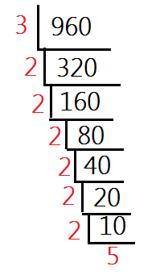
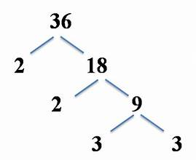
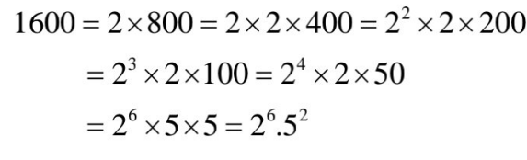
Division Method.
Tree Diagram.
Multiplication.

Slide 17
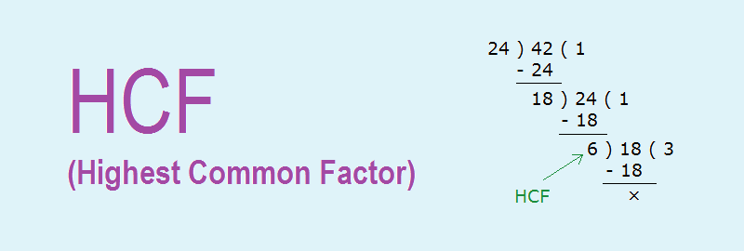
HCF
HCF or Highest Common Factor is the greatest number which divides each of the two or more numbers.
HCF is also called the Greatest Common Measure (GCM) and Greatest Common Divisor(GCD).
Step 1: Write each number as a product of its prime factors. This method is called here prime factorization.
Step 2: Now list the common factors of both the numbers
Step 3: The product of all common prime factors is the HCF ( use the lower power of each common factor)

Slide 18
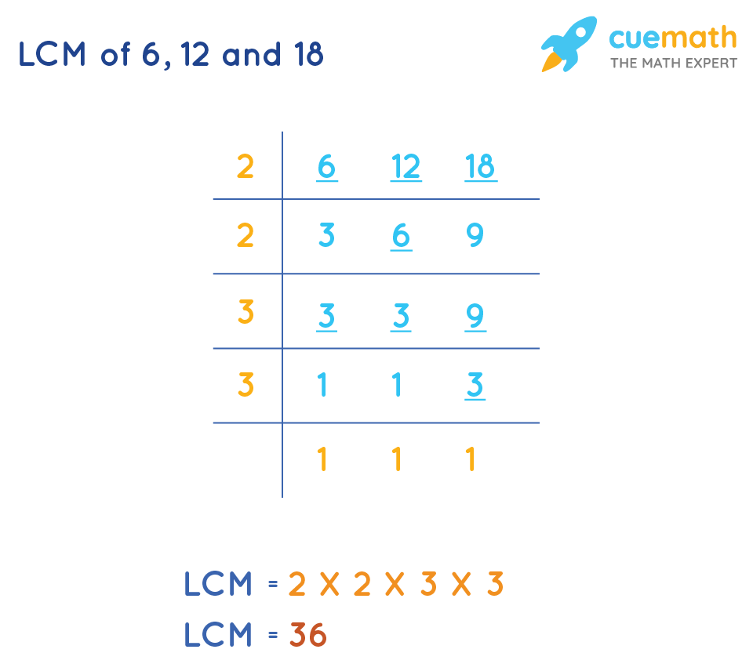
LCM
The LCM of any two is the value that is evenly divisible by the two given numbers.
The full form of LCM is Least Common Multiple.
It is also called the Least Common Divisor (LCD).
Step 1: List the first few multiple of each number.
Step 2: Circle the common multiples.
Step 3: The lowest circled number is the LCM.

